Slide 1

Instrumentation and Control
CSE 325
We are all in the gutter, but some of us are looking at the stars.
-Oscar Wilde
Mehedi Hasan
Lecturer
Computer Science and Engineering(CSE)
Daffodil International University(DIU)

Slide 2
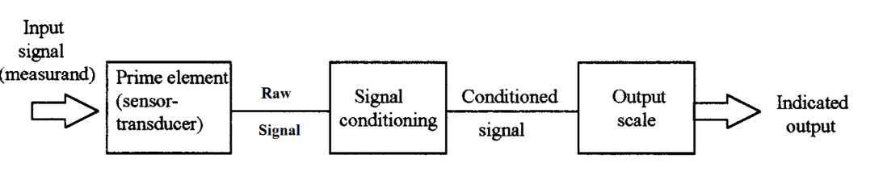
Signal Conditioning Systems
Signal conditioning refers to operations performed on signals to convert to a suitable for interfacing with other elements in the instrumentation process.
➢ The raw signal may:
➢ be too small – have to be amplified
➢ contain noise – have to be removed
➢ be non-linear – need linearization
➢ be analog – have to make digital
➢ be digital – have to make analog
➢ be hazardous – require isolation
The conditioned signal is then transferred to the output stage (for indication, recording, logging etc.) which provides the value corresponding to the measurand.

Slide 3
Elements of Signal Conditioning System
The following are some of the processes that can occur in conditioning a signal:
❖ Conversion – getting the signal into the right type of signal
❖ Change of signal level – getting the level of the signal right
❖ Eliminating or reducing noise – increasing the signal-to-noise ratio (SNR)
❖ Linearization – making the output linear of the measurand
❖ Impedance/load matching – for proper power coupling
❖ Protection – to prevent damage to the next element/component

Slide 4
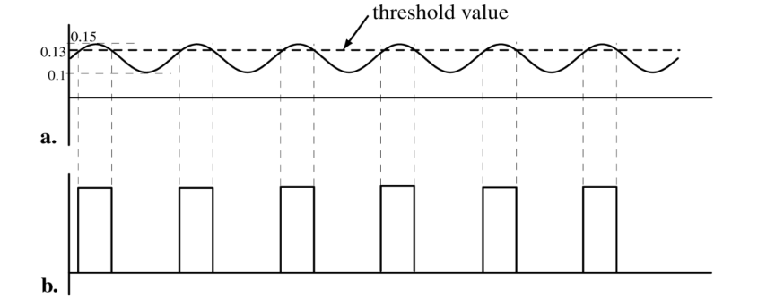
Conversion – getting the signal into the right type of signal
Analog to Digital and Digital to Analog Converters
Threshold Digitization
It is sufficient to use a threshold comparator which will then produce a digital output.
Output from magnetic pick-up circuit varies from 100 mV to 150 mV (for example).
The threshold is set by the resistors to 0.13V.
The output is zero until the voltage on the (+) input rises above the threshold.
When the input dips below 0.13V the output goes back to zero.
➢
Now, each pulse represents a rotation of the rotor. Counting the pulses in a given time can give the speed of rotation of the rotor or other data (e.g. flow rate)

Slide 5
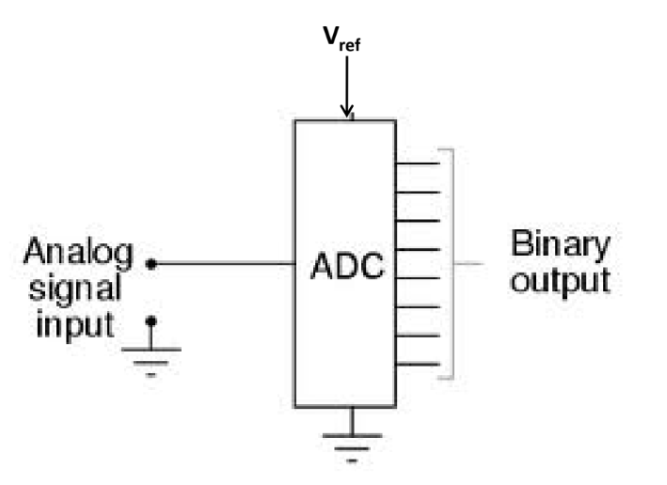
Analog to Digital Conversion
Converts analog signals into binary numbers/words
Why the conversion:
Processing by a computer or by logic circuits, including arithmetic operations, comparison, sorting, ordering, and code conversion
Storage on electronic media until ready for further handling
Display in numerical or graphical form on a computer/other digital device
Digital transmission for less error

Slide 6
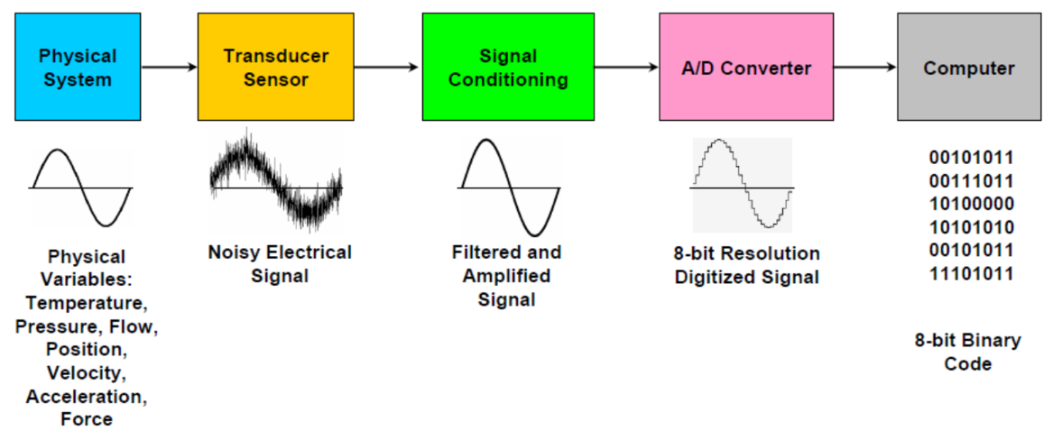
Analog to Digital Conversion
Where do we use an ADC?

Slide 7
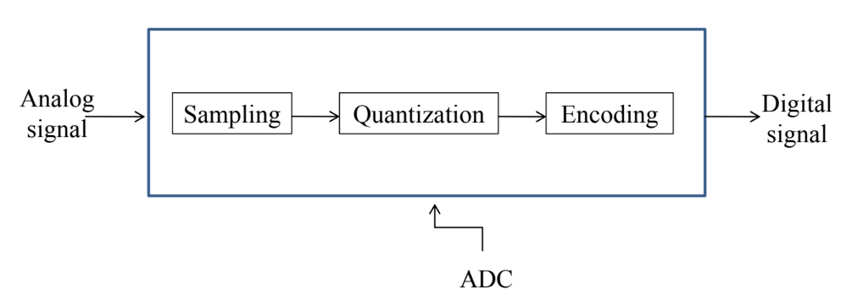
Analog to Digital Conversion
Steps in A/D Conversion:
Analog signal: continuous in time and magnitude
Sampled signal: discrete in time but can be of any magnitude
Quantized signal: discrete in magnitude
Digital signal: coded quantized signal

Slide 8
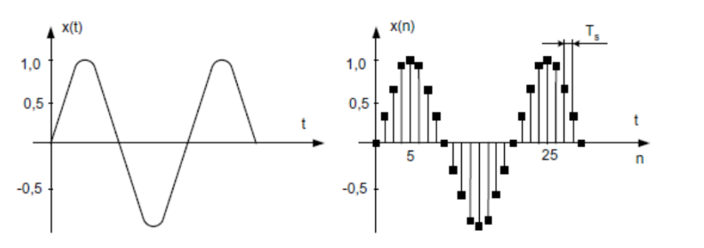
Analog to Digital Conversion : Sampling
Sampling converts analog signal (continuous in time and magnitude) into discrete time signal (discrete in time but can have any magnitude)
The intervals, t_{s} , must be carefully chosen to ensure an accurate representation of the original analogue signal.

Slide 9
Analog to Digital Conversion : Sampling
The problem of losing information in the sampling process, it is necessary to recall Shannon’s information theorem and Nyquist’s criteria.
Shannon’s information theorem states the following.
• An analogue signal with a bandwidth of f_{a} must be sampled at a rate of f_{s} > 2f_{a}
To avoid loss of information.
• The signal bandwidth may extend from d.c. to f_{a} or from f₁ to f₂, where fa = f₂ − f₁
The Nyquist criterion is as follows.
• If f_{s} < 2f_{a}, then a phenomenon called aliasing will occur.
To avoid aliasing and loss of information, sampling frequency must be at least twice the highest frequency of the signal.

Slide 10
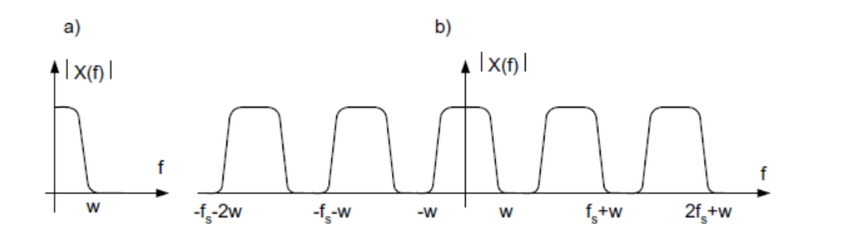
Analog to Digital Conversion : Sampling
The signals in the above figure were sampled with the frequency f_{s} > 2w.

Slide 11
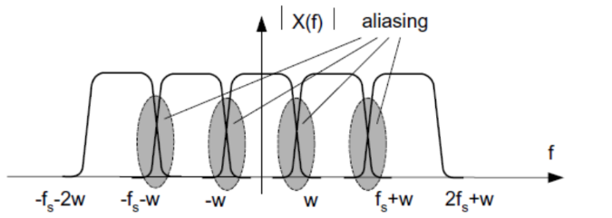
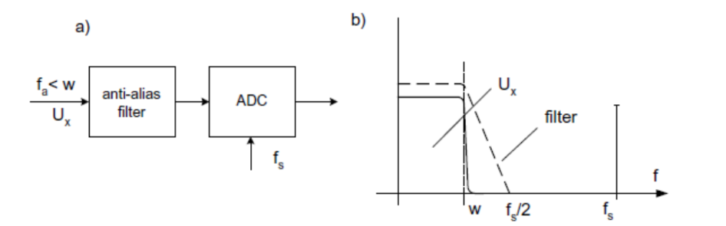
Analog to Digital Conversion : Sampling
Aliasing is the distortion caused when a signal is sampled below the Nyquist rate, resulting in overlap of frequency components.
If f_{s} < 2f_{a}, the replicated signal bands interfere mutually and a distorted signals appear at the output. This effect is called aliasing.
Anti-aliasing filter: An anti-aliasing low-pass filter is used before sampling to limit the signal bandwidth to the Nyquist frequency $\left(f_{s}/2\right)$, thus preventing aliasing.

Slide 12
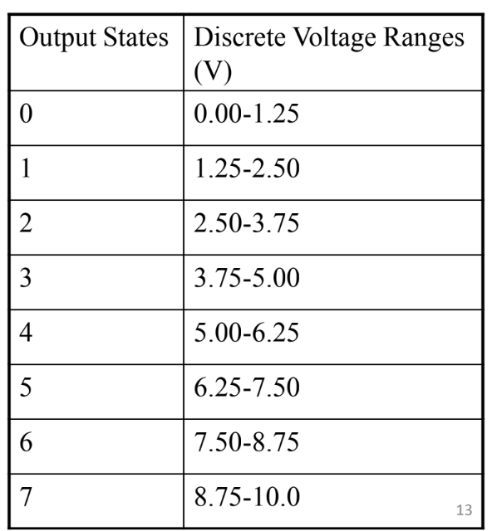

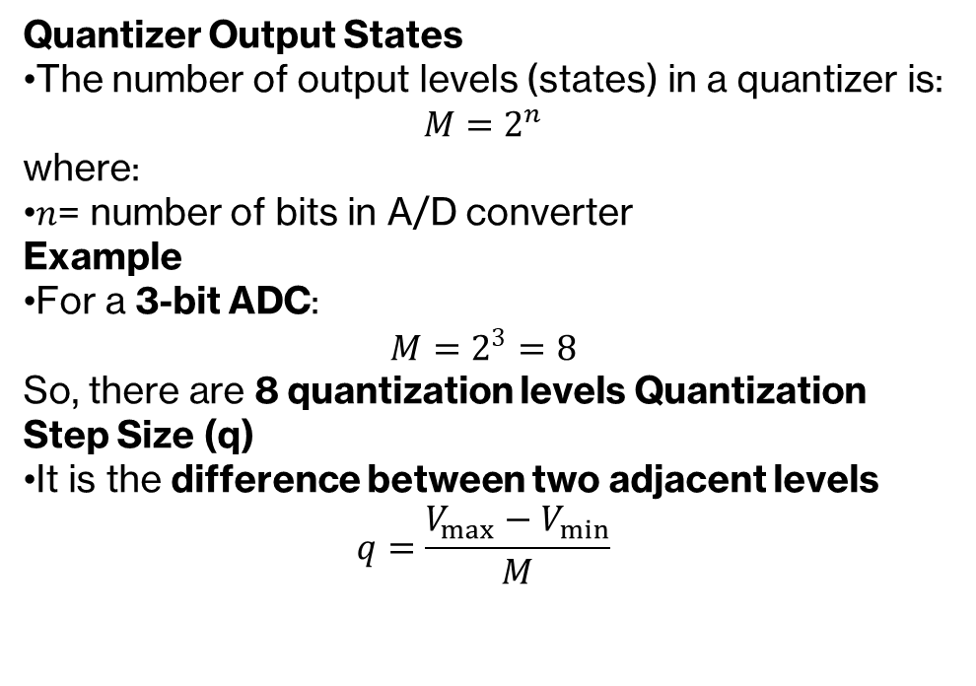
Analog to Digital Conversion : Quantization
Quantization is breaking down the values of the sampled signal into a set of finite number of quantized values
Example:
We have 0-10V signals. Separate them into a set of discrete states with 1.25V increments. (How did we get 1.25V?)
Quantizer Output States
The number of output levels (states) in a quantizer is:
$$M=2^{n}$$
where:
$n$= number of bits in A/D converter
Example
For a 3-bit ADC:
$$M=2^{3}=8$$
So, there are 8 quantization levels Quantization Step Size (q)
It is the difference between two adjacent levels
$$q=\frac{V_{max}−V_{min}}{M}$$
$$q=\frac{10−0}{8}=1.25V$$

Slide 13
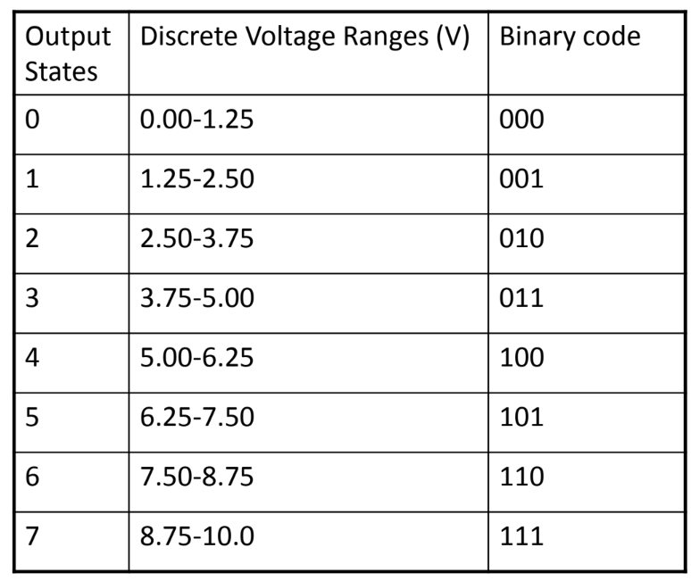
Analog to Digital Conversion : Encoding
Encoding is the process of converting quantized values into binary (digital) form.
A unique digital number/word is assigned to each of the quantized states

Slide 14
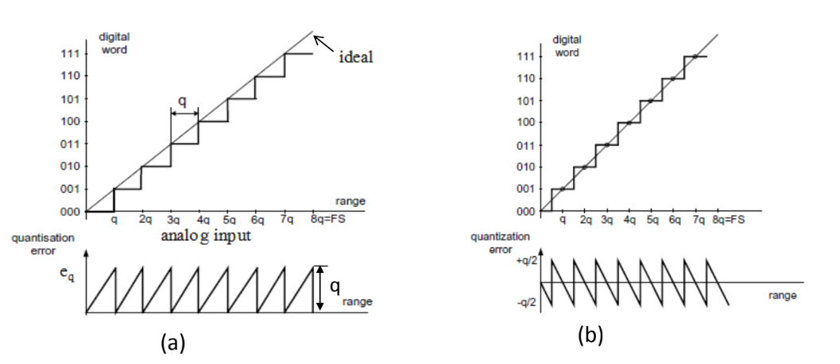
Analog to Digital Conversion : Transfer characteristics
From Fig (a) we can see that the quantization error is varying between 0 and q Value.
Usually the characteristic of the quantization is shifted by the q/2 value thus the error of quantization is varying between –q/2 and +q/2 (Fig. b).

Slide 15
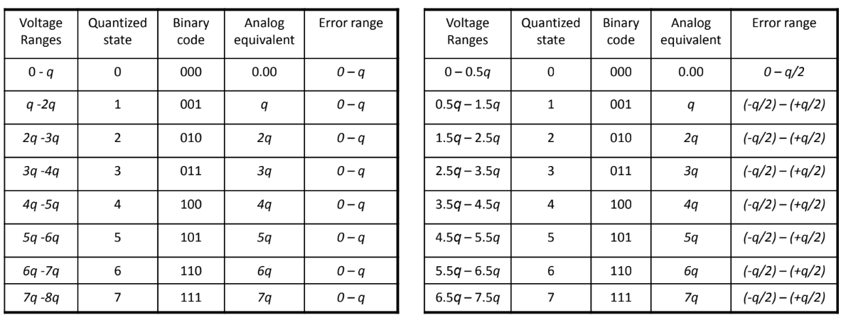
Analog to Digital Conversion : Transfer characteristics

